Slide 1

GoVenture Entrepreneur Simulation Outbrief
-Vikas Sanil
vsanil1@hawk.iit.edu

Slide 2

Lemonade Stand
Introduction:
When started selling lemonades in single kiosks went for mixed-quality ingredients hence the profit margin was not as great since more money was spent on a good quality product.
Still, customer satisfaction was not good whenever inventory quality used to drop.
Growth
After buying the other two kiosks realized the quality of the ingredients should be according to the customer profile and would improve customer satisfaction.
Maintaining inventory was an issue as predicting customer inflow on a particular day was tough.
Avoided buying items in excess since they would get spoiled very fast.
Maturity
Towards the end of simulation days, realized on a hot weather day customers would buy even the low-quality ingredient drink without any complaint. Tried this strategy just to test how the game algorithm is programmed and it worked. Bettered profit margin using this.

Slide 3
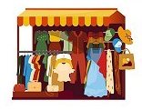
Kiosk - Clothing
Introduction
Started out in a shopping mall since it had a steady and overall higher customer footfall compared to other locations.
Took some time to figure right combination between customer footfall and store opening time.
Took some time to realize health is related to the amount of time spent in the store and doesn’t have any correlation with the number of employees I had.
Growth
After buying the cart stayed at one location(Arena) not realizing it had a maximum footfall of only two days. Started moving to a different location and then settled on a location that had maximum footfall on days when Arena had less.
Invested in advertising to increase footfall in shops.
Maturity
Improved customer satisfaction by moving the best employees around the stores based on the peak footfall.
Employee management didn’t have many parameters and the game allowed constant movement of employees without an off day.

Slide 4
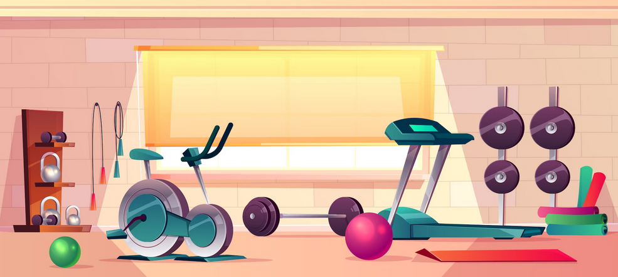
Full Business - GYM
Introduction
Contribution of products (drink, food, and t-shirt) for the profit margin took some time to realize.
Maintaining the inventory of products became more complex in this game since there was no clear correlation between weather and customer buying habits.
Maintaining a price point for the product also took some time as the customer profile didn’t give much insight into it.
Growth
Hiring new employees was tricky as they had different skill levels and personal attributes. Tried to hire employees with more reliability at the start.
Marketing was more complex here and learned changing strategies based on equipment and service present in the facility.
Maturity
Maintaining employee morale became tough as they hated training and expected constant salary hike.
Lost employees with a better reliability score at the start of the game so it became very tough to maintain employees with less reliability score.
Didn’t get a full understanding of Social Responsibility.

